Slide 1
History of Health Education / Promotion
Chapter 2

Slide 2

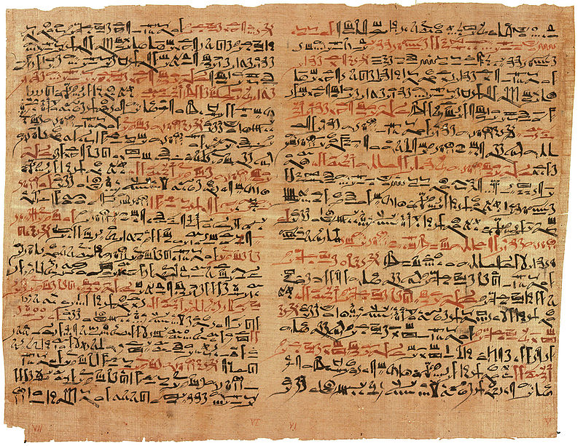
Historical health beliefs and practices
Babylon, Code of Hammurabi (2080 BC):
  set rates for physician fees for services (transparency in pricing!)
Egypt (3000-1000BC):
  Cultural emphasis on personal hygiene
  Public health: sanitation (covered drainage pipes, privies)
  Philosophy of health/disease: religious basis; priests were physicians, source of health information and treatment

Slide 3
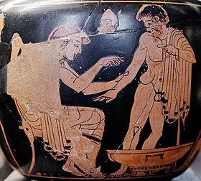
Historical health beliefs and practices
Greeks (1000-400 BC):
  Influence still seen in current perspectives on health/disease
  Focus is on balance: physical, mental, spiritual aspects of a person
  Emphasis on disease prevention through personal actions
  Understanding of disease still shaped by religion, but over time, shift towards “scientific” (empirically-based) view of medicine

Slide 4

Historical health beliefs and practices
Hippocrates
  Good health: result of balance; Disease: result of imbalance
  To maintain good health: engage in physical activity, study, philosophical discussion with others, good nutrition, rest.
  Hippocrates’ theory of disease causation still employed through early 20th century
  Observed, recorded associations between diseases and geography, climate, diet, living conditions
  “First epidemiologist:” identified distinction between endemic and epidemic disease
  Hippocratic Oath
Notes:
Associations between disease & geography, climate, diet, living conditions—in contrast with then-current beliefs in associations between disease and will of god(s)

Slide 5


Historical health beliefs and practices
Romans (500 BC-500 AD):
  Aqueducts
  Underground sewers
  Hospitals, public medical service
  Study of anatomy

Slide 6
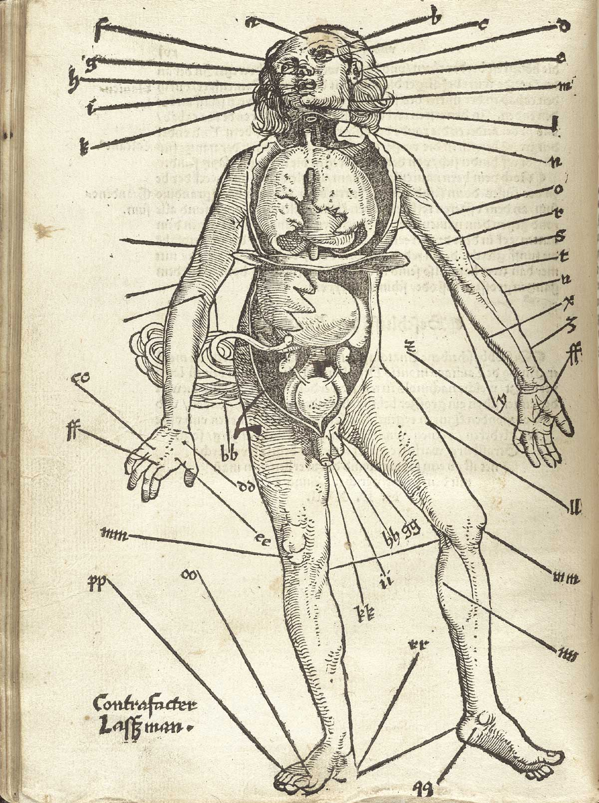
Historical health beliefs and practices
Middle Ages (500 – 1500 AD):
  Shift to religious (Christian) views on health/disease; rejection of previous medical knowledge
    Duality/split between spirit & body
    Cultural de-emphasis on personal hygiene
  Marked by recurrence of epidemics
    Was understood that plague and other diseases were contagious, but chain of transmission unknown
Renaissance (1500 -1700 AD)
  Treatment of disease rudimentary, one-size-fits-all (barber/surgeon vs. physician)
  John Graunt (London), study of Bills of Mortality
  Italy: expansion of duties of health boards
Notes:
Graunt: statistics & epidemiology. Uncovered patterns like higher birth rate for males than females; higher death rates during 1st years of life, then tapering off; higher death rates for city dwellers than rural people.
Italy: health boards dated to middle ages, to fight plague. By mid 16th century, responsibilities included food commerce (meat, fish, agricultural products), sewage systems, hospitals, burials/cemeteries, physicians/surgeons, apothecaries, preparation & sale of drugs.

Slide 7
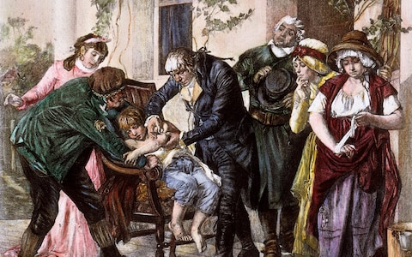
Historical health beliefs and practices
Age of Enlightenment (1700s)
  Industrialization, urbanization
  Still no full understanding of disease (“miasmas theory”) but, some significant advances:
    Edward Jenner, smallpox vaccine
    Shift away from mind/body duality
  In US: contagious diseases rampant
    Crowding, immigration
    Disease control: quarantine, environmental cleanliness, but no oversight

Slide 8
Urban life, 19th century

Slide 9
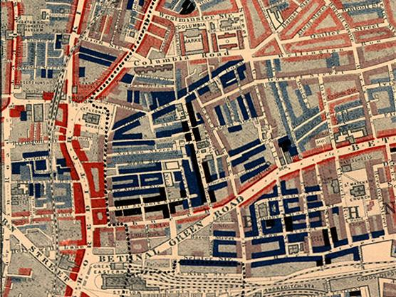
Poverty Map of London, Charles Booth 1889
Reds: lower middle class
Light blue: poor
Dark blue: very poor
Black: unemployed
Notes:
Rich & poor living right next to each other; employment of servants brought rich/poor households into close contact

Slide 10
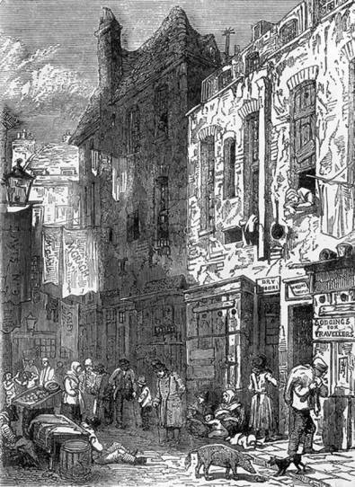
The St. Giles Rookery, London 1849

Slide 11
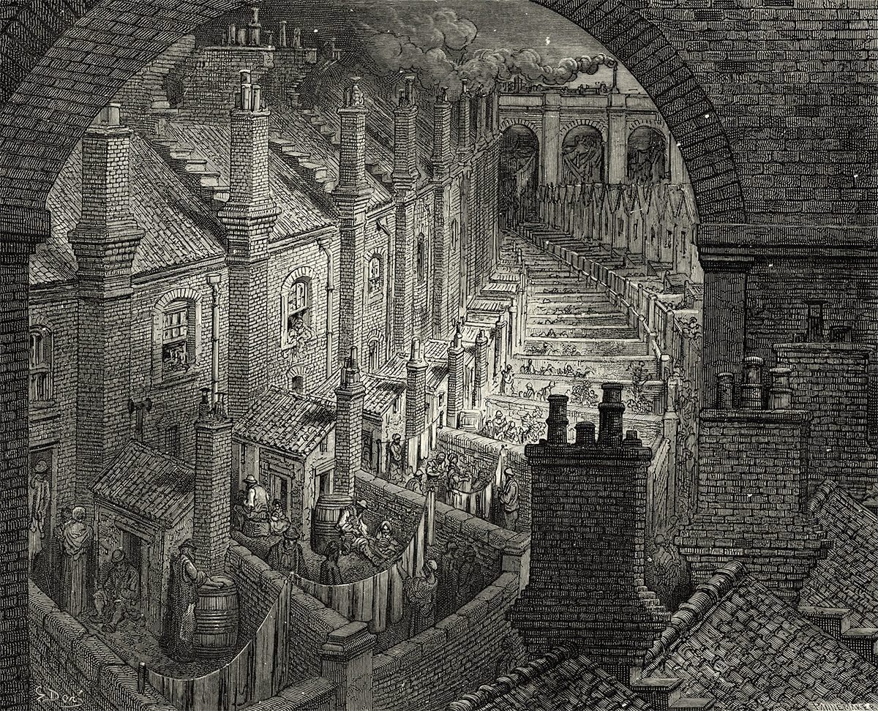
“Slums of London,” Gustave Dore 1850

Slide 12
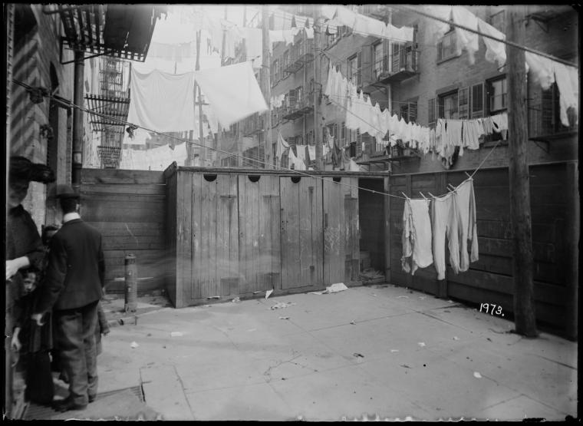

Tenement privies, New York City

Slide 13
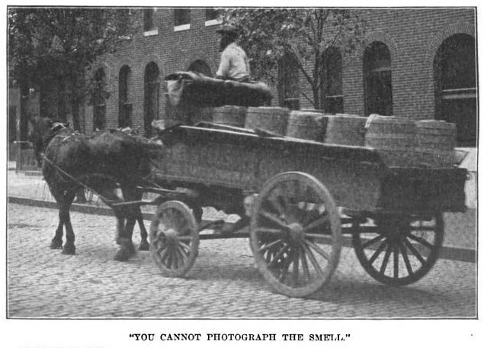
“Night soil men”

Slide 14
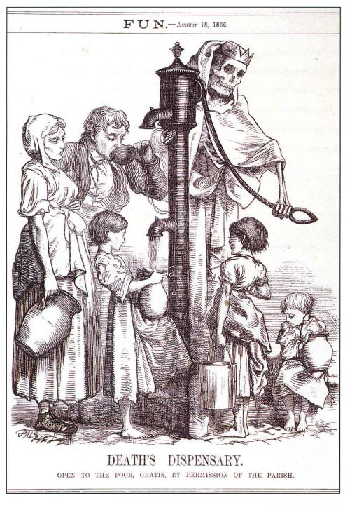

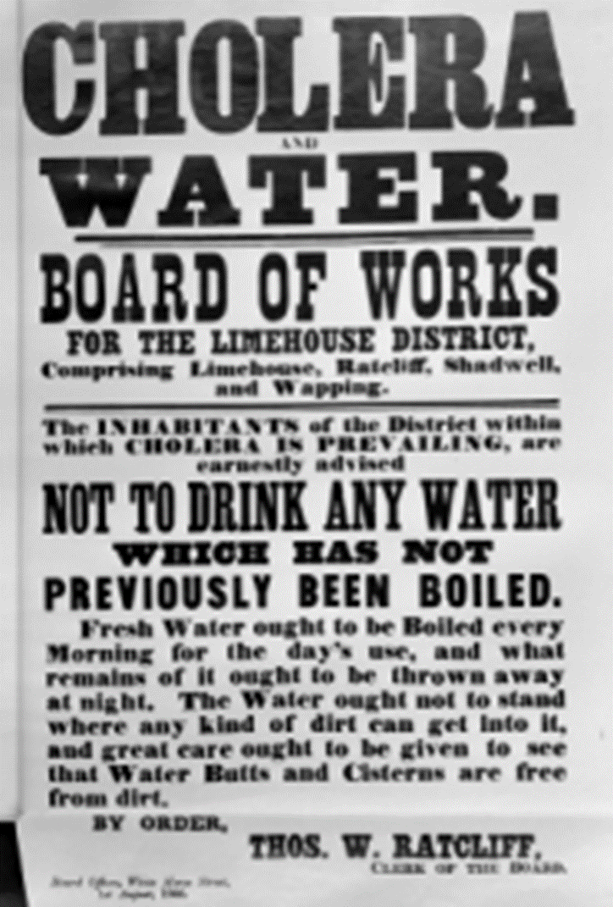
Water pumps

Slide 15
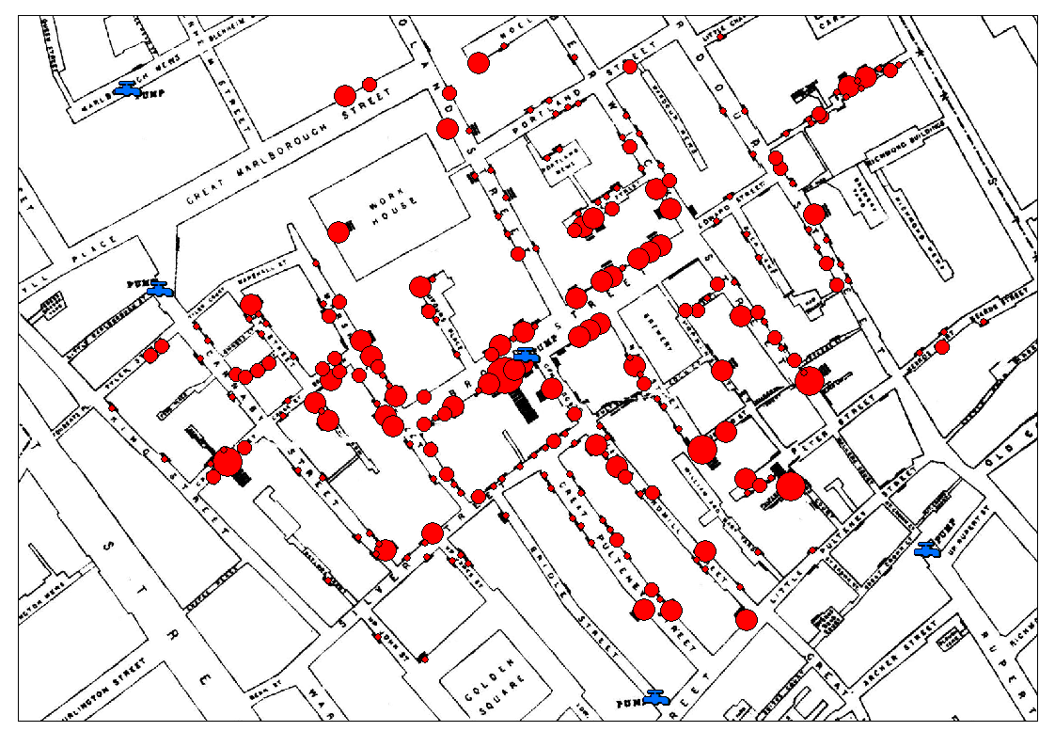
John Snow’s map

Slide 16
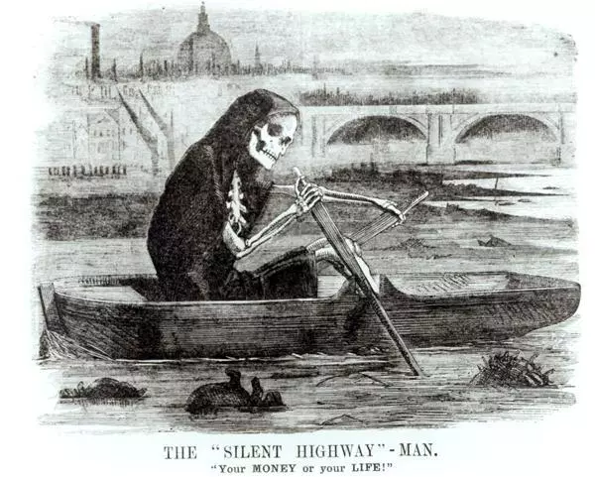
The “Great Stink” 1858
Death rows on the Thames, claiming the lives of victims who have not paid to have the river cleaned up, during the Great Stink. Published in Punch 10 July, 1858, the cartoon pointed the finger of blame directly at politicians who had refused to fund sewerage and water purification treatments for the city and river.

Slide 17
Historical health beliefs and practices
Europe in 1800s:
  First half of century, little change/improvement
  Edwin Chadwick, Report on an Inquiry into the Sanitary Conditions of the Labouring Population of Great Britain
  Dr. John Snow, outbreak investigation (epidemiology)
  Louis Pasteur, germ theory of disease
  Joseph Lister, antiseptic method of treating wounds
  1875-1900: bacteriological period of public health
Notes:
Marine Hospital Service Act: first prepaid medical & hospital insurance plan in the world. Marine Hospital Service became Public Health and Marine Hospital Service, then just the U.S. Public Health Service

Slide 18
Historical health beliefs and practices
US in 1800s:
  First half of century, little change/improvement
  Lemuel Shattuck, Report of the Sanitary Commission of Massachusetts
  Foundation of state, local, and national boards of health
  Foundation of American Public Health Association
  Marine Hospital Service Act

Slide 19
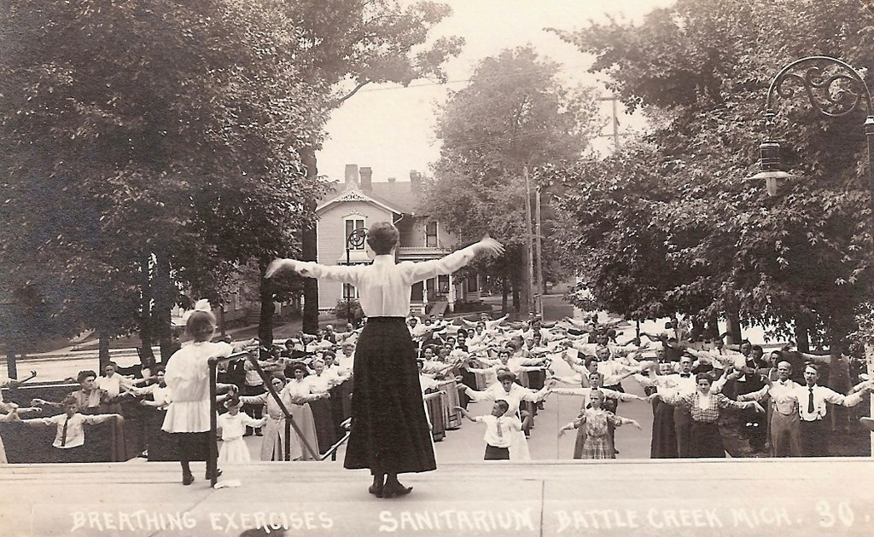
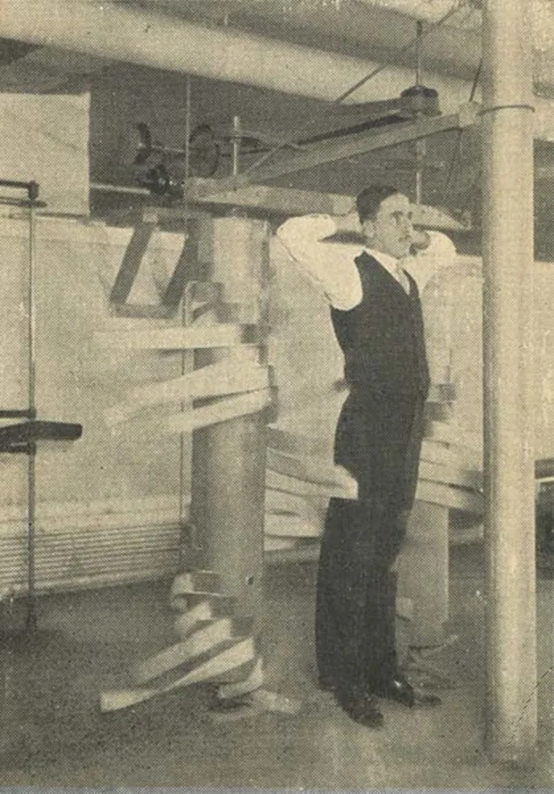
Historical health beliefs and practices
1900-1920s: reform phase of public health
  Regulation of food industry, US. Department of Labor,
  Formation of Public Health Education Section of APHA
  Prevention--very mixed bag: Kellogg brothers, their sanitarium
  Tension between preventive medicine, curative medicine appears
Later 20th century:
  Social Security Act 1935
  Formation of National Institute of Health, Centers for Disease control and Prevention
  Hill-Burton Act
  Dr. Derryberry calls for attention to prevention of chronic disease (1954)
  Medicare and Medicaid
  Lalonde Report

Slide 20
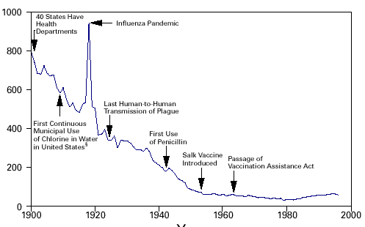
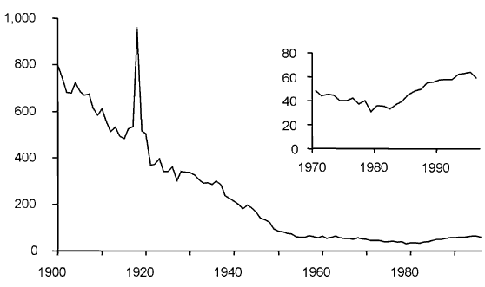
20th century achievements in Public Health
Crude death rate (per 100,000) for infectious diseases 1900-1996

Slide 21
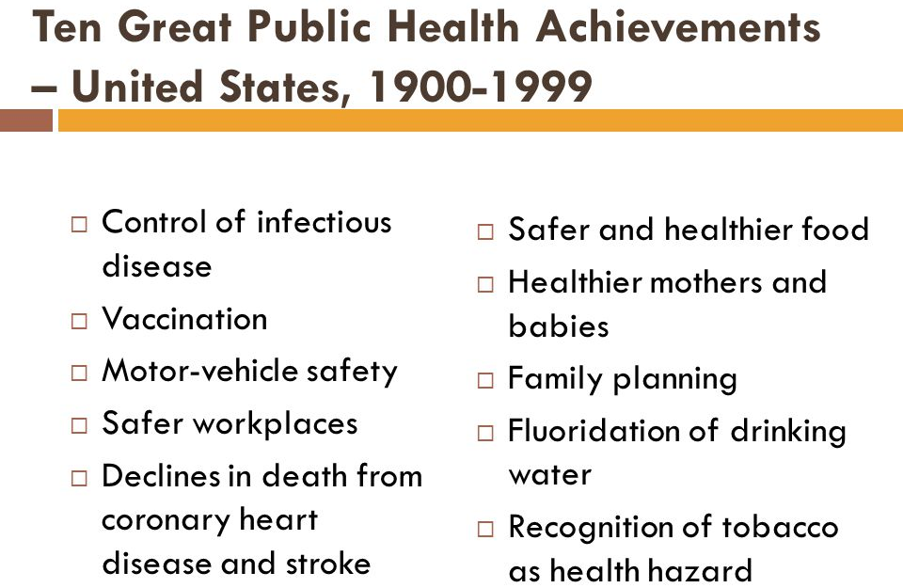
20th century achievements in Public Health

Slide 22
School health development 19th-early 20th century
Horace Mann: call for mandatory “hygiene” programs (1843)
The Shattuck Report: included call for teaching of “physiology” (1850)
Women’s Christian Temperance Union: by 1890, every state required education on effects of alcohol and narcotics
Child Health Organization of America (Sally Lucas Jean): call for functional health education/promotion programs, name change from “hygiene education” to “health education” (1910s)
WWI (1917), WWII (1941): calls to action due to number of men declared unfit to serve

Slide 23
School health development mid – late 20th century
School Health Education Study: inconsistency in education, rampant misconceptions (1964).
School Health Education Evaluation Study (1970s)
Definition of coordinated school health program (1980s)

Slide 24

Coordinated School Health Program
Eight components:
  Health Education
  Physical Education
  Health Services
  Nutrition Services
  Counseling, Psychological, and Social Services
  Healthy School Environment
  Health Promotion for School Staff
  Family and Community Involvement
Promise vs. implementation

Slide 25
Health education
Comprehensive school health instruction
  Development and delivery of planned, sequential, effective school health instruction program
  Curriculum “designed to motivate and assist students to maintain and improve their health, prevent disease, and reduce health-related risk behaviors”
  Emphasis on 6 risk behaviors, monitored by the YRBSS
National Health Education Standards, American Cancer Society (2006)
  Promoting health literacy
National Board Certification (2008)

Slide 26
Patient Protection and Affordable Care Act
Includes multiple provisions for health education/promotion (2010)
Timeline for implementation, p. 66
Results: mixed bag

